Slide 1

FAKE NEWS DETECTION PROJECT
Submitted by:
VijaySinghArjunSingh Pardeshi

Slide 2
Introduction
Fake news's simple meaning is to incorporate information that leads people to the wrong path. Nowadays fake news spreading like water and people share this information without verifying it. This is often done to further or impose certain ideas and is often achieved with political agendas.
For media outlets, the ability to attract viewers to their websites is necessary to generate online advertising revenue. So it is necessary to detect fake news.

Slide 3
Problem statement
The authenticity of Information has become a longstanding issue affecting businesses and society, both for printed and digital media. On social networks, the reach and effects of information spread occur at such a fast pace and so amplified that distorted, inaccurate, or false information acquires a tremendous potential to cause real-world impacts, within minutes, for millions of users.
The goal of this project is to use natural language processing techniques to automate stance detection, since it is not practical for humans to fact check every piece of information produced by the media

Slide 4
Exploratory Data Analysis
Checking shape of data.
Checking data types of each features using dataframe.info() function.
checking for null values in each column,and treating them.
Pointing out irrelevant features in dataset like ‘id’,unnamed:0’.
Addition of new features to check the length of headline and news before and after preprocessing.
Cleaning the raw data-It involves deletion of words or special characters that do not add meaning to the text.

Slide 5
Exploratory Data Analysis
Important cleaning steps are:
Lowering case
Handling of special characters
Removal of stopwords
Handling of hyperlinks
Removing leading and trailing white space
Replacing urls with web address
Converted words to most suitable base form by using lemmatization

Slide 6
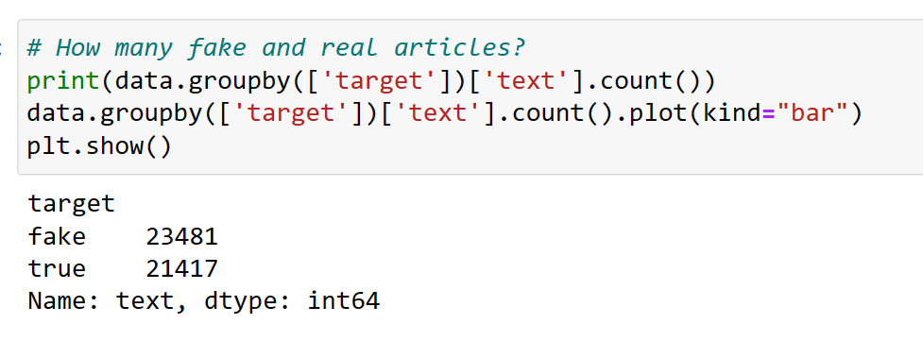
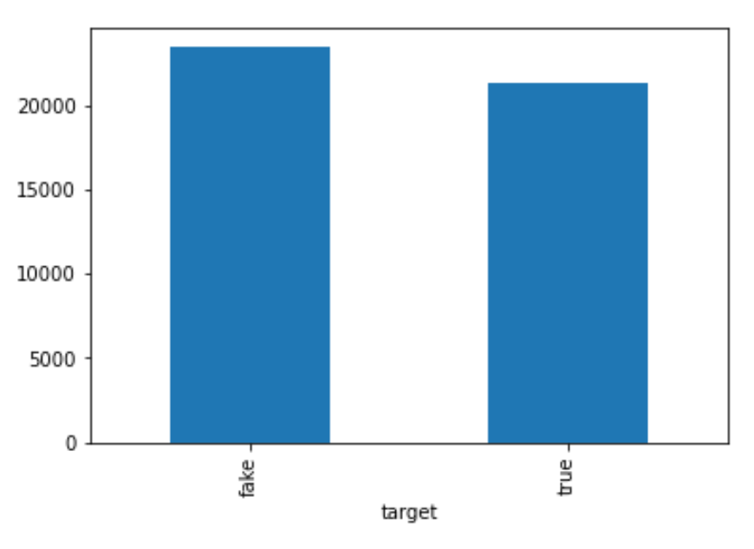
Checking distribution of fake and true news
We see that both news are almost equally distributed .ie dataset is balanced which is good as it will help our model to classify more accurately, so we should expect good accuracy score.

Slide 7
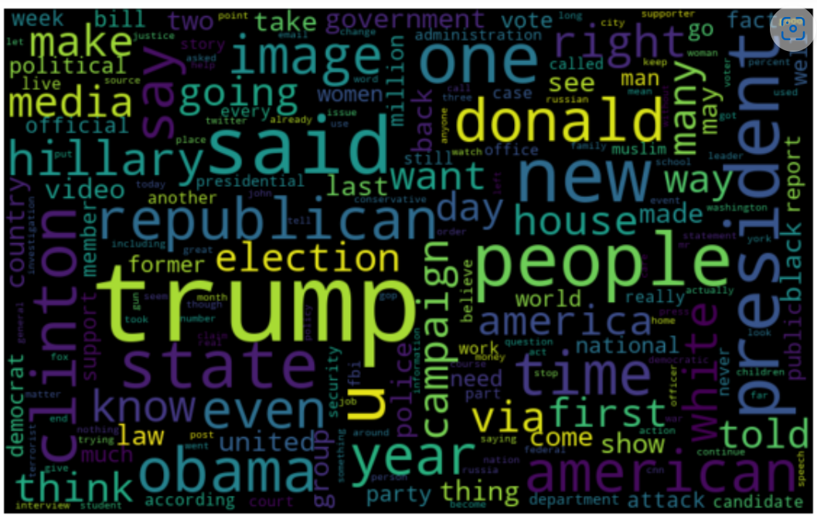
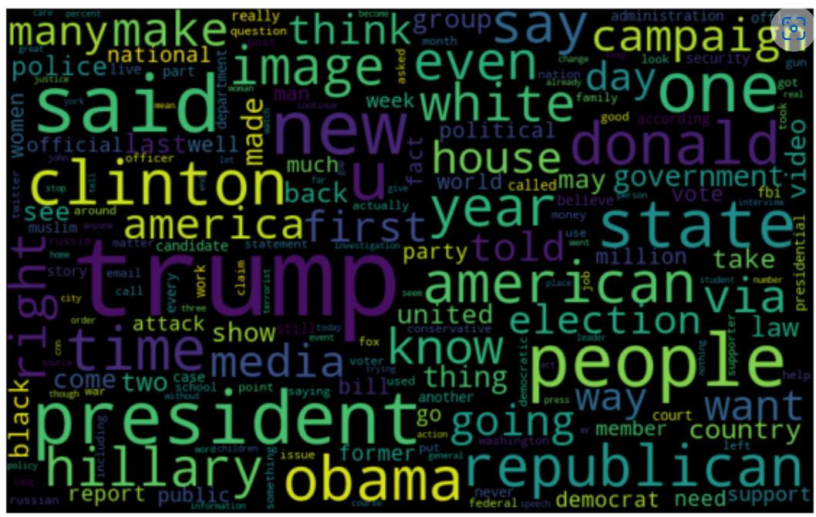
loud words in real News - Headline
loud words in fake News - Headline

Slide 8
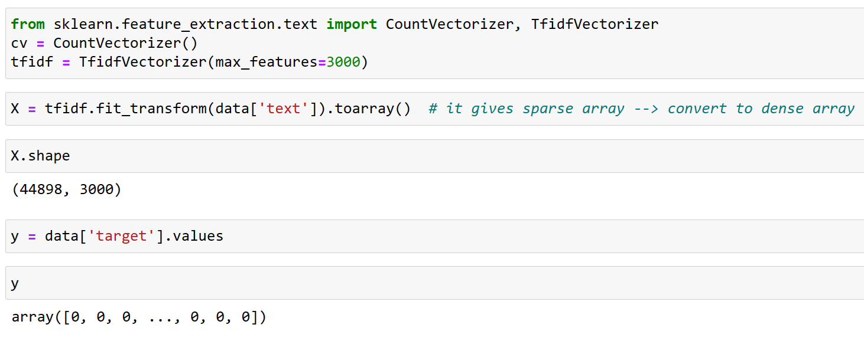
Training Classifier: We converted all the comment text into vectors , using TF-IDF. Then we have split features and label.

Slide 9
Model Building & Performance
it’s a binary classification type problem and below models were used:
LogisticRegression
DecisionTreeClassifier
RandomForestClassifier
AdaBoostClassifier
MultinomialNB
XGBoost Classifier

Slide 10
Evaluation Matrices
Accuracy - it determines how often a model predicts default and non default correctly. Confusion matrices :It gives direct comparisons of values like True Positives, False Positives, True Negatives and False Negatives
classification report :It displays the precision, recall, F1, and support scores for the model
F1 score - the F1-score, is a measure of a model's accuracy on a dataset. It is used to evaluate binary classification systems, which classify examples into 'positive' or 'negative'. AUC: It represents the degree or measure of separability. It tells how much the model is capable of distinguishing between
Log_Loss:For any given problem, a lower log loss value means better predictions

Slide 11
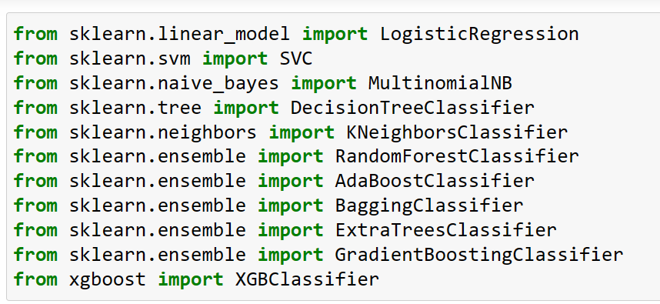
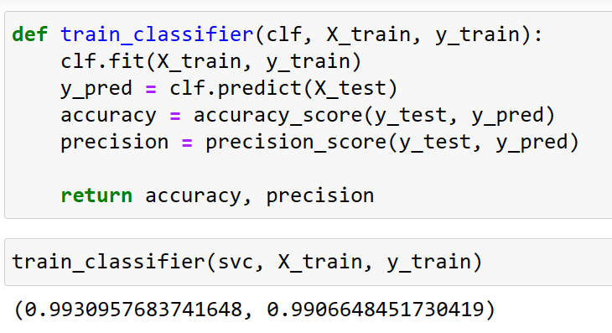
All algorithm by using for loop

Slide 12
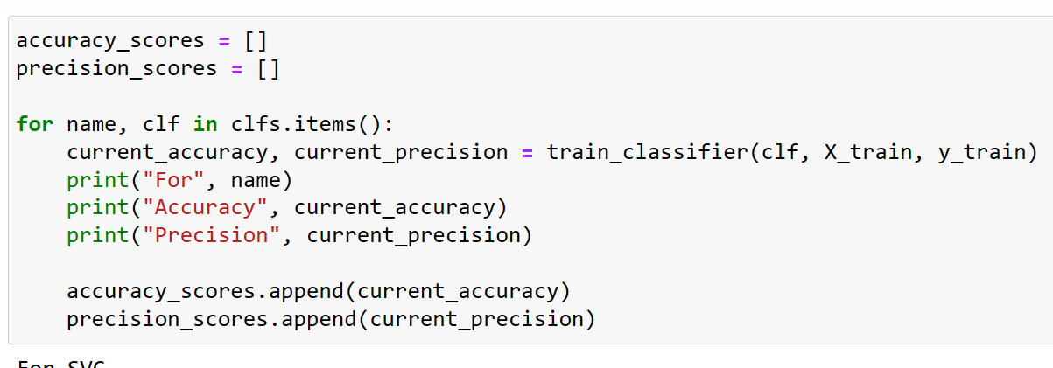
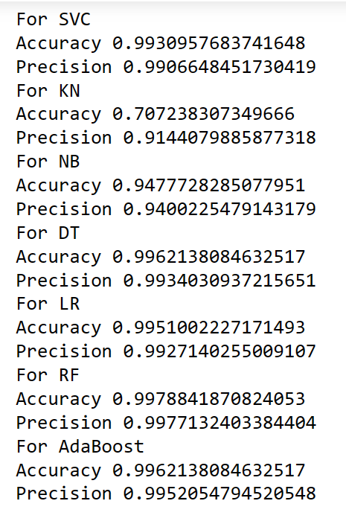
All algorithm by using for loop

Slide 13
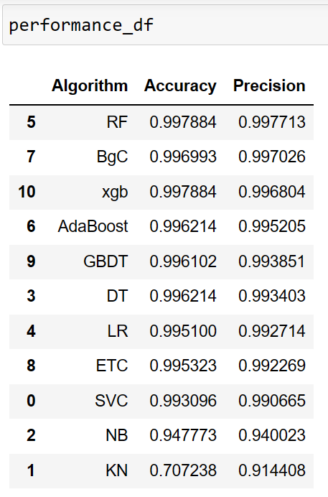
We choose Random Forest Classifier model as the final one, as it gives hightest accuracy score & also higher precision Value.

Slide 14
Hyper parameter tuning of best model

Slide 15
Saving the best model

Slide 16
Conclusion
Machine Learning Algorithms like XGBoost, Adaboost and Randomforest Classifier took an enormous amount of time to build the model. Using Hyper-parameter tuning for XGB would have resulted in some more accuracy.
The saved model now can help to give an estimate of probability about the type of news being fake or real.
It was overall a nice experience on working on a real time project of NLP domain to see how data science and machine learning is useful in this field.

